Slide 1
Security Devices Intrusion Prevention and Detection Devices

Slide 2
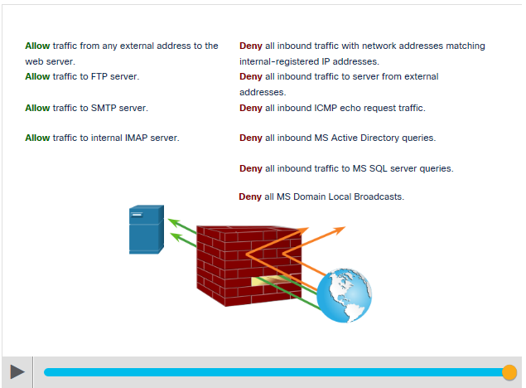
Security Devices Firewalls
A firewall is a system, or group of systems, that enforces an access control policy between networks.
Common Firewall Properties:
Resistant to network attacks
The only transit point between internal corporate networks and external networks because all traffic flows through the firewall
Enforce the access control policy
Notes:
12 – Network Security Infrastructure
12.2 – Security Devices
12.2.2 – Firewalls

Slide 3
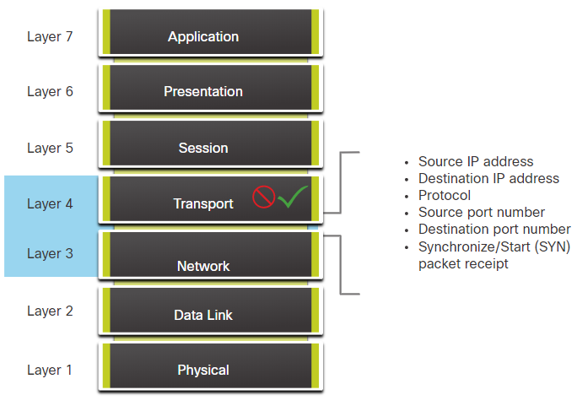
Security Devices Firewall Type Descriptions
The different types of firewalls are:
Packet Filtering (Stateless) Firewall
Packet Filtering firewalls are part of a router firewall, which permits or denies traffic based on Layer 3 and Layer 4 information.
They are stateless firewalls that use a simple policy table look-up that filters traffic based on specific criteria.
Notes:
12 – Network Security Infrastructure
12.2 – Security Devices
12.2.3 – Firewall Type Descriptions

Slide 4
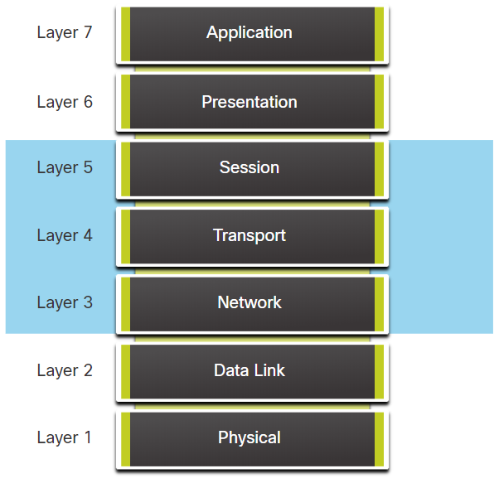
Security Devices Firewall Type Descriptions (Contd.)
Stateful Firewalls
Stateful firewalls are the most versatile and the most common firewall technologies in use.
These firewalls provide stateful packet filtering by using connection information maintained in a state table.
Notes:
12 – Network Security Infrastructure
12.2 – Security Devices
12.2.3 – Firewall Type Descriptions

Slide 5
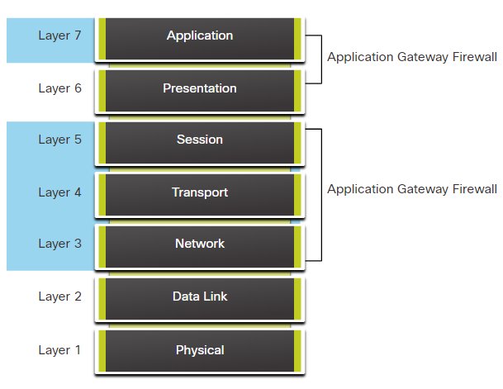
Security Devices Firewall Type Descriptions (Contd.)
Application gateway firewall (proxy firewall)
Application gateway firewall filters information at Layers 3, 4, 5, and 7 of the OSI reference model.
Most of the firewall control and filtering is done in the software.
Notes:
12 – Network Security Infrastructure
12.2 – Security Devices
12.2.3 – Firewall Type Descriptions

Slide 6
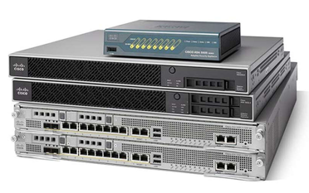
Security Devices Firewall Type Descriptions (Contd.)
Next-generation firewalls (NGFW)
NGFW go beyond stateful firewalls by providing:
Integrated intrusion prevention
Application awareness and control to see and block risky apps
Upgrade paths to include future information feeds
Techniques to address evolving security threats
Notes:
12 – Network Security Infrastructure
12.2 – Security Devices
12.2.3 – Firewall Type Descriptions

Slide 7
Security Devices Firewall Type Descriptions (Contd.)
Other methods of implementing firewalls include:
Host-based (server and personal) firewall - A PC or server with firewall software running on it.
Transparent firewall - Filters IP traffic between a pair of bridged interfaces.
Hybrid firewall - A combination of various firewall types.
Notes:
12 – Network Security Infrastructure
12.2 – Security Devices
12.2.3 – Firewall Type Descriptions
12.2.4 – Check Your Understanding - Identify the Type of Firewall

Slide 8
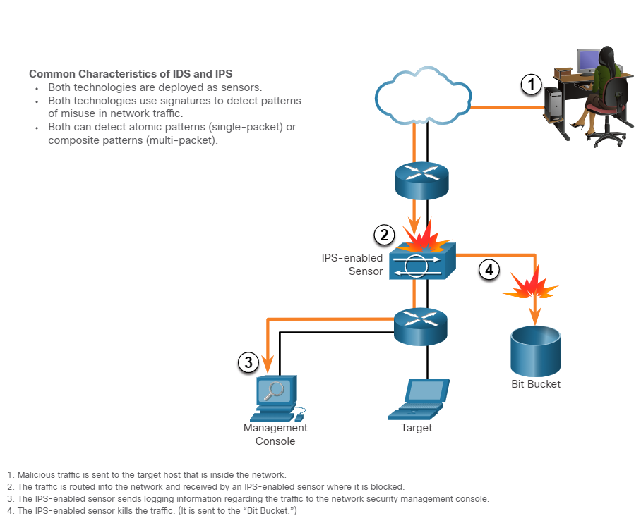
Security Devices Intrusion Prevention and Detection Devices
A networking architecture paradigm shift is required to defend against fast-moving and evolving attacks. This must include cost effective and prevention systems such as:
Intrusion Detection Systems (IDS)
Intrusion Prevention Systems (IPS)
The network architecture integrates these solutions into the entry and exit points of the network.
The figure shows how an IPS device handles malicious traffic.
Notes:
12 – Network Security Infrastructure
12.2 – Security Devices
12.2.5 – Intrusion Prevention and Detection Devices

Slide 9
Security Devices Advantages and Disadvantages of IDS and IPS
The table lists the advantages and disadvantages of IDS and IPS:
Solution | Advantages | Disadvantages
IDS | No Impact on network (latency, jitter) No Network impact if there is a sensor failure No network impact if there is sensor overload | Response action cannot stop trigger packets Correct tuning required for response actions More vulnerable to network security evasion techniques
IPS | Stops trigger packets Can use stream normalization techniques | Sensor issues might affect network traffic Sensor overloading impacts the network Some impact on network (latency, jitter)
Deployment Consideration:
IPS and IDS technologies can complement each other.
Deciding which implementation to use is based on the security goals of the organization as stated in their network security policy.
Notes:
12 – Network Security Infrastructure
12.2 – Security Devices
12.2.6 – Advantages and Disadvantages of IDS and IPS

Slide 10
Security Devices Types of IPS
There are two primary kinds of IPS :
Host-based IPS
Network-based IPS
Host-based IPS (HIPS)
HIPS is a software installed on a host to monitor and analyze suspicious activity.
Advantages | Disadvantages
Provides protection specific to a host operating system Provides operating system and application level protection Protects the host after the message is decrypted | Operating system dependent Must be installed on all hosts
Notes:
12 – Network Security Infrastructure
12.2 – Security Devices
12.2.7 – Types of IPS

Slide 11
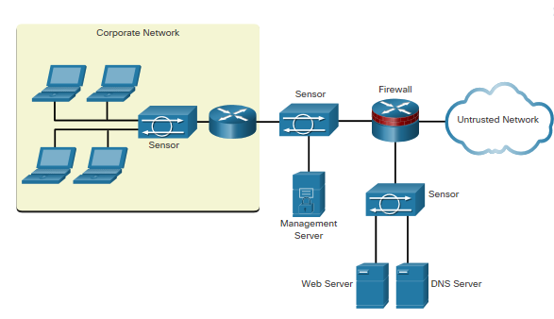
Security Devices Types of IPS (Contd.)
Network-based IPS
Network-based IPS are Implemented using a dedicated or non-dedicated IPS device.
Host-based IDS/IPS solutions are integrated with a network-based IPS implementation to ensure a robust security architecture.
Sensors detect malicious and unauthorized activity in real time and can take action when required.
Notes:
12 – Network Security Infrastructure
12.2 – Security Devices
12.2.7 – Types of IPS

Slide 12
Security Devices Specialized Security Appliances
Few examples of specialized security appliances.
Cisco Advanced Malware Protection (AMP) | Cisco Web Security Appliance (WSA) | Cisco Email Security Appliance (ESA)
An enterprise-class advanced malware analysis and protection solution | A secure web gateway that combines leading protections to help organizations address the growing challenges of securing and controlling web traffic | ESA/Cisco Cloud Email Security helps to mitigate email-based threats and the ESA defends mission-critical email systems
It provides comprehensive malware protection for organizations before, during, and after an attack | Protects the network by automatically blocking risky sites and testing unknown sites before allowing users to access them | Constantly updated by real-time feeds from Cisco Talos, which detects and correlates threats using a worldwide database monitoring system
 |  | Features: Global threat intelligence, Spam blocking, Advanced Malware Protection, Outbound Message Control
Notes:
12 – Network Security Infrastructure
12.2 – Security Devices
12.2.8 – Specialized Security Appliances
12.2.9 – Check Your Understanding - Compare IDS and IPS Characteristics

Slide 13
12.3 Security Services
Notes:
Source:
12 – Network Security Infrastructure
12.3 – Security Services
In-Session Activities / Explanations:
Time: 15 min
Instructor Notes:
In this topic, the leaners will get a knowledge of the different security services available.
List the important features of ACL
Discuss Simple Network Management Protocol (SNMP) with the help of an example.
Describe NetFlow
Briefly explain port mirroring
Discuss Syslog servers
Explain NTP
Ensure that the learners complete the “Check Your Understanding - Identify the Network Security Device or Service” in section 12.3.12.
Walk the learners through AAA servers
Describe VPN
Key Points: ACL, SNMP, NetFlow, Port Mirroring, Syslog Server, NTP, AAA, VPN

Slide 14
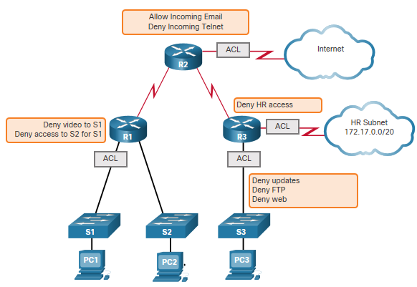
Security Services Traffic Control with ACLs
An Access Control List (ACL) is a series of commands that control whether a device forwards or drops packets based on information found in the packet header.
When configured, ACLs perform the following tasks:
Limit network traffic to increase network performance.
Provide traffic flow control.
Provide basic level of security for network access.
Filter traffic based on traffic type.
Screen hosts to permit or deny access to network services.
Sample Topology with ACLs applied to routers R1, R2, and R3.
Notes:
12 – Network Security Infrastructure
12.3 – Security Services
12.3.2 – Traffic Control with ACLs

Slide 15
Security Services ACLs: Important Features
The two types of Cisco IPv4 ACLs are:
Standard ACL - Used to permit or deny traffic only from source IPv4 addresses.
Extended ACL - Filters IPv4 packets based on several attributes that include:
Protocol type
Source IPv4 address
Destination IPv4 address
Source TCP or UDP ports
Destination TCP or UDP ports
Optional protocol type information for finer control
Standard and extended ACLs can be created using either a number or a name to identify the ACL and its list of statements.
Notes:
12 – Network Security Infrastructure
12.3 – Security Services
12.3.3 – ACLs: Important Features

Slide 16
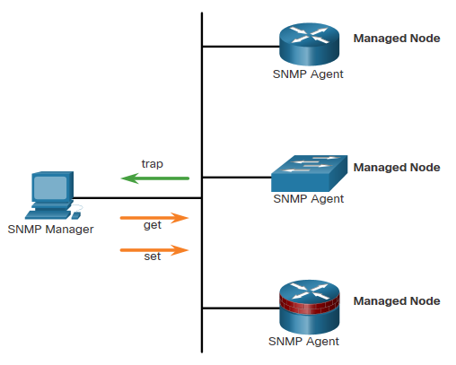
Security Services SNMP
Simple Network Management Protocol (SNMP) is an application layer protocol that provides a message format for communication between managers and agents.
It allows network administrators to perform the following:
Manage end devices such as servers, workstations, routers, switches, and security appliances, on an IP network.
Monitor and manage network performance.
Find and solve network problems.
Plan for network growth.
The SNMP system consists of two elements:
SNMP manager: Runs SNMP management software.
SNMP agents: Nodes being monitored and managed.
Notes:
12 – Network Security Infrastructure
12.3 – Security Services
12.3.5 – SNMP

Slide 17
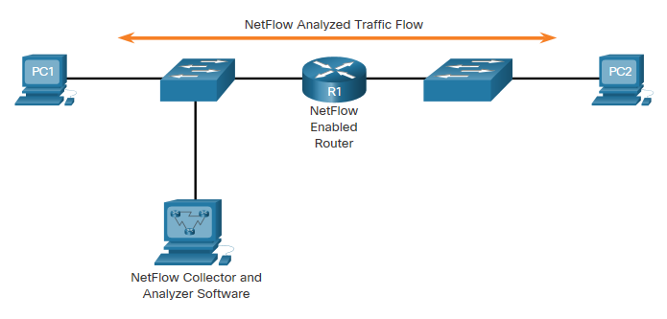
Security Services NetFlow
NetFlow is a Cisco IOS technology that provides statistics on packets flowing through a Cisco router or multilayer switch.
NetFlow provides data to enable:
network and security monitoring,
network planning
traffic analysis to include identification of network bottlenecks
IP accounting for billing purposes.
NetFlow can monitor application connection, tracking byte and packet counts for that individual application flow.
It then pushes the statistics over to an external server called a NetFlow collector.
PC 1 connects to PC 2 using HTTPS
Notes:
12 – Network Security Infrastructure
12.3 – Security Services
12.3.6 – NetFlow

Slide 18
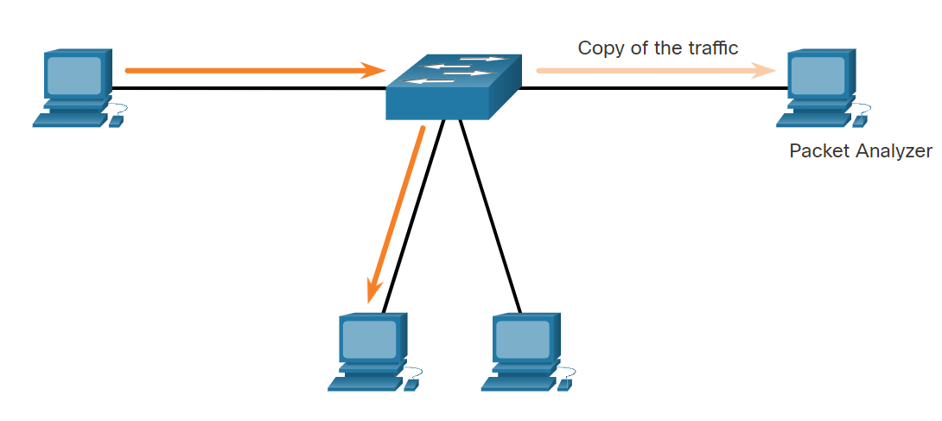
Security Services Port Mirroring
Port mirroring is a feature that allows a switch to make duplicate copies of traffic passing through a switch, and then sending it out a port with a network monitor attached.
Traffic Sniffing Using a Switch
Notes:
12 – Network Security Infrastructure
12.3 – Security Services
12.3.7 – Port Mirroring

Slide 19
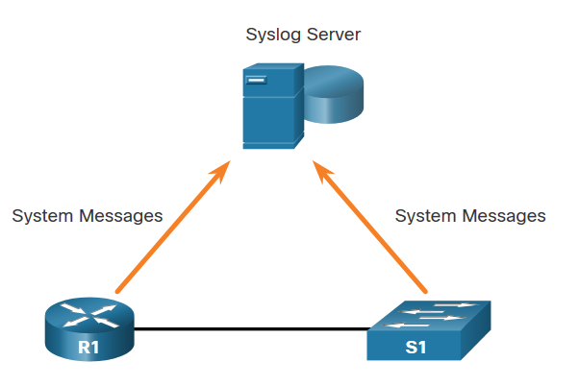
Security Services Syslog Servers
The most common method of accessing system messages is to use a protocol called syslog.
The Syslog protocol allows networking devices to send their system messages across the network to syslog servers.
It provides three primary functions:
The ability to gather logging information for monitoring and troubleshooting
The ability to select the type of logging information that is captured
The ability to specify the destination of captured syslog messages
Syslog
Notes:
12 – Network Security Infrastructure
12.3 – Security Services
12.3.8 – Syslog Servers

Slide 20
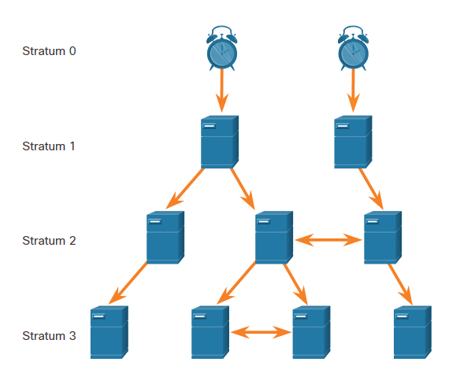
Security Services NTP
It is important to synchronize the time across all devices on the network. The date and time settings on a network device can be set using one of two methods:
Manual configuration of the date and time
Configuring the Network Time Protocol (NTP)
NTP networks use a hierarchical system of time sources, where each level in this system is called a stratum. NTP servers are arranged in three levels known as strata:
Stratum 0: An NTP network gets the time from authoritative time sources.
Stratum 1: Devices are directly connected to the authoritative time sources.
Stratum 2 and lower strata: Stratum 2 devices, such as NTP clients, synchronize their time using the NTP packets from stratum 1 servers.
NTP Stratum Levels
Notes:
12 – Network Security Infrastructure
12.3 – Security Services
12.3.9 – NTP

Slide 21
Security Services AAA Servers
The below table lists the three independent security functions provided by the AAA architectural framework.
Functions | Description
Authentication | Users and administrators must prove that they are who they say they are. Authentication can be established using username and password combinations, challenge and response questions, token cards, and other methods. AAA authentication provides a centralized way to control access to the network.
Authorization | After the user is authenticated, authorization services determine which resources the user can access and which operations the user is allowed to perform. An example is “User ‘student’ can access host serverXYZ using SSH only.”
Accounting | Accounting records what the user does, including what is accessed, the amount of time the resource is accessed, and any changes that were made. Accounting keeps track of how network resources are used. An example is "User ‘student’ accessed host serverXYZ using SSH for 15 minutes."
Notes:
12 – Network Security Infrastructure
12.3 – Security Services
12.3.10 – AAA Servers

Slide 22
Security Services AAA Servers (Contd.)
The below table lists the difference between Terminal Access Controller Access-Control System Plus (TACACS+) and Remote Authentication Dial-In User Service (RADIUS) protocols.
 | TACACS+ | RADIUS
Functionality | Separates AAA according to the AAA architecture, | Combines authentication and authorization but separates accounting,
Standard | Mostly Cisco supported | Open/RFC standard
Transport | TCP | UDP
Protocol CHAP | Bidirectional challenge and response as used in Challenge Handshake Authentication Protocol (CHAP) | Unidirectional challenge and response from the RADIUS security server to the RADIUS client
Confidentiality | Entire packet encrypted | Password encrypted
Customization | Provides authorization of router commands on per-user or per-group basis | No option to authorize router commands on a per-user or per-group basis
Accounting | Limited | Extensive
Notes:
12 – Network Security Infrastructure
12.3 – Security Services
12.3.10 – AAA Servers

Slide 23
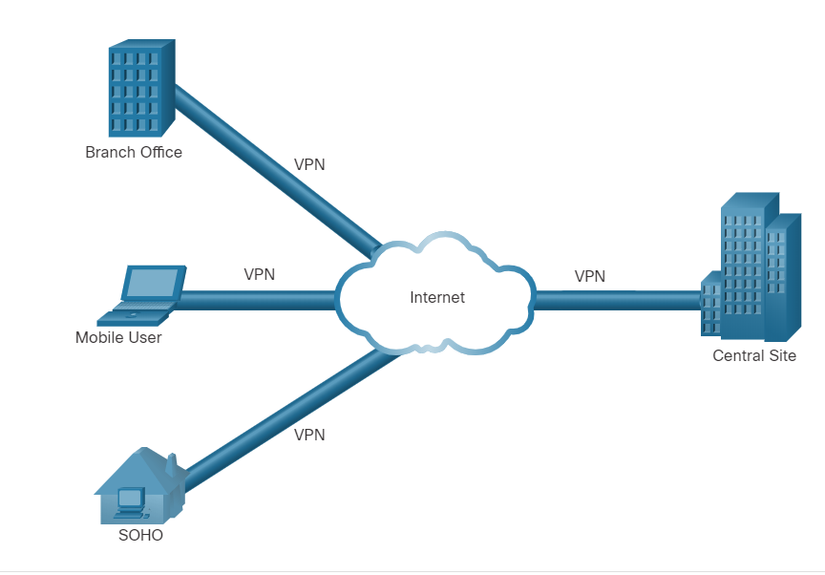
Security Services VPN
A VPN is a private network that is created over a public network (usually the internet).
A VPN uses virtual connections routed through the Internet from the organization to the remote site.
A VPN is a communications environment in which access is strictly controlled to permit peer connections within a defined community of interest.
Confidentiality is achieved by encrypting the traffic within the VPN.
In short, VPN connects two endpoints over a public network, to form a logical connection which can be made at Layer 2 or Layer 3.
Virtual Private Network
Notes:
12 – Network Security Infrastructure
12.3 – Security Services
12.3.11 – VPN
12.3.12 – Check Your Understanding - Identify the Network Security Device or Service

Slide 24
12.4 Network Security Infrastructure Summary
Notes:
Source:
12 – Network Security Infrastructure
12.4 – Network Security Infrastructure Summary
In-Session Activities / Explanations:
Time: 5 min
Instructor Notes:
Read out the summary points mentioned on the slide.
Discuss the same with the participants.
Ask if they have any questions or doubts.
At the end, ask the students to complete the module quiz.
Key Points: NA

Slide 25
Network Security Infrastructure Summary What Did I Learn in this Module?
Networks are typically represented as physical and logical topologies.
A physical topology represents physical connections and how end devices are connected whereas a logical topology refers to the standards and protocols that devices use to communicate.
The two most common types of network infrastructures are LANs and WANs.
The campus wired LAN design consists of hierarchical layers (access, distribution, core) with each layer assigned specific functions.
Common security architectures define the boundaries of traffic entering and leaving the network.
The different types of firewalls are Packet filtering firewalls, stateful inspection firewall, Application gateway firewalls, Next-generation firewalls.
Notes:
12 – Network Security Infrastructure
12.4 – Network Security Infrastructure Summary
12.4.1– What Did I Learn in this Module?

Slide 26
Network Security Infrastructure Summary What Did I Learn in this Module? (Contd.)
Intrusion prevention systems (IPS) and intrusion detection systems (IDS) are used to detect potential security risks and alert/stop unsafe traffic.
Specialized security appliances are available including Cisco Advanced Malware Protection (AMP), Cisco Web Security Appliance (WSA), and Cisco Email Security Appliance (WSA).
ACLs are a series of statements that control whether a device forwards or drops packets based on information found in the packet header.
SNMP enables network administrators to monitor and manage network performance, find and solve network problems, and plan for network growth.
NetFlow provides statistics on packets that are flowing through a Cisco router or multilayer switch.
Port mirroring is a feature that allows a switch to make duplicate copies of traffic that is passing through the switch, and then send it out a port that has a network monitor attached.
Notes:
12 – Network Security Infrastructure
12.4 – Network Security Infrastructure Summary
12.4.1– What Did I Learn in this Module?

Slide 27
Network Security Infrastructure Summary What Did I Learn in this Module? (Contd.)
Syslog servers compile and provide access to the system messages generated by networking devices.
NTP synchronizes the system time across all devices on the network to ensure accurate and consistent timestamping of system messages.
AAA is a framework for configuring user authentication, authorization, and accounting services. It typically uses a TACACS+ or RADIUS server for this purpose.
VPNs are private networks that are created between two endpoints across a public network.
Notes:
12 – Network Security Infrastructure
12.4 – Network Security Infrastructure Summary
12.4.1– What Did I Learn in this Module?
12.4.2 – Module 12: Network Security Infrastructure Quiz

Slide 28
Module 12 New Terms and Commands
Topology Diagram Demilitarized Zone (DMZ) Zone-based Policy Firewalls (ZPF) Packet Filtering Firewall Stateful Firewall Application gateway Firewall (Proxy Firewall) Next- Generation Firewall(NGFW) Host based Firewall Transparent Firewall Hybrid Firewall | Intrusion Detection Systems(IDS) Intrusion Prevention Systems(IPS) Cisco Advanced Malware Protection(AMP) Cisco Web Security Appliance (WSA) Cisco Cloud Web Security (CWS) Cisco Email Security Appliance (ESA) Access Control List (ACL) | Standard ACL Extended ACL Simple Network Management Protocol (SNMP) NetFlow Port Mirroring Syslog Server Network Time Protocol (NTP) Stratum TACACS+ RADIUS VPN
Notes:
12 – Network Security Infrastructure
New Terms and Commands

